Slide 1
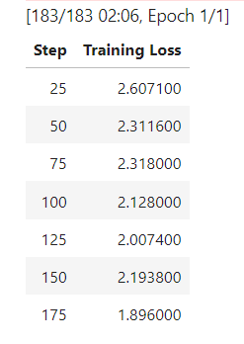
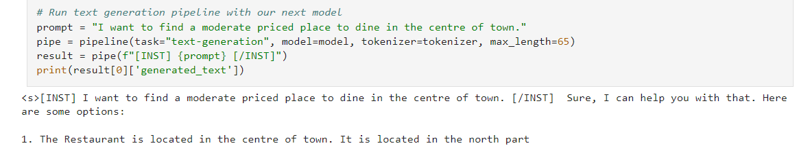

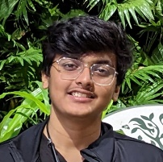

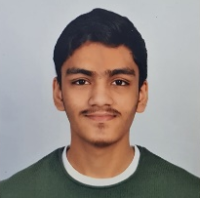

GORDON : A CULINARY COMPANION CHATBOT
Data/Library/Pre-processing
Torch
Transformers
Datasets
OS
Model Highlights
Importing Libraries
Loading Dataset
Training Model
Generating Response
Training/Testing Results
<text>
<text>
<text>
<text>
Student Learning
Deep Learning Techniques
Python/Tensor flow
Hugging face
Problem Statement
Design an AI-driven restaurant chatbot capable of recommending restaurants, making reservations and understanding dish names providing descriptions from a given menu dataset, enhancing the user's restaurant experience.
t
CHATBOT
Recommendation
Source Code
USER
NLP Component
Menu Dataset
GORDON – A restaurant chatbot that understands dish names and generates detailed descriptions from a provided menu, improving the dining experience with user-friendly interactions.
The chatbot offers users the ability to input dish names and receive comprehensive dish descriptions, enhancing menu exploration and customer engagement.
Team members
Project Initiation
Searching for problem statements
Ideation
Planning and Requirements
Exploration of the open source code.
Data Generation
Research
PC based experimentation
Design & Prototype
Further Data Generation
Model verification with test samples.
Testing…
Debugging
Final Reporting & Documentation
Fine tuning…
Output Verification
Final Touches
RA2212701010011
Jai Singh
2/Mtech. Int./AI
RA2212701010051
Lakshay Kothari
2/Mtech. Int./AI
RA2211026010433 Mrugan Kulkarni
2/CSE/AIML
Source code link: https://github.com/Neural-Netwits/Chatbot_Gordon/blob/main/Chatbot_Gordon.ipynb

